Slide 1
REST-baserade tjänster med WCF ASP.NET Web API
Robert Folkesson
Active Solution

Slide 2
Who AM I?

Slide 3
REST?
Dissertation by Roy Fielding 2000
“Architectural Styles and the Design of Network-based Software Architectures”
ReST = Representational State Transfer

Slide 4
Architectural constraints
Client–server
Stateless
Cacheable
Layered system
Uniform Interface
Notes:
Client–server
A uniform interface separates clients from servers. This separation of concerns means that, for example, clients are not concerned with data storage, which remains internal to each server, so that the portability of client code is improved. Servers are not concerned with the user interface or user state, so that servers can be simpler and more scalable. Servers and clients may also be replaced and developed independently, as long as the interface between them is not altered.
Stateless
The client–server communication is further constrained by no client context being stored on the server between requests. Each request from any client contains all of the information necessary to service the request, and any session state is held in the client. The server can be stateful; this constraint merely requires that server-side state be addressable by URL as a resource. This not only makes servers more visible for monitoring, but also makes them more reliable in the face of partial network failures as well as further enhancing their scalability.
Cacheable
As on the World Wide Web, clients can cache responses. Responses must therefore, implicitly or explicitly, define themselves as cacheable, or not, to prevent clients reusing stale or inappropriate data in response to further requests. Well-managed caching partially or completely eliminates some client–server interactions, further improving scalability and performance.
Layered system
A client cannot ordinarily tell whether it is connected directly to the end server, or to an intermediary along the way. Intermediary servers may improve system scalability by enabling load-balancing and by providing shared caches. They may also enforce security policies.
Code on demand (optional)
Servers are able temporarily to extend or customize the functionality of a client by the transfer of executable code. Examples of this may include compiled components such as Java applets and client-side scripts such as JavaScript.
Uniform interface
The uniform interface between clients and servers, discussed below, simplifies and decouples the architecture, which enables each part to evolve independently. The four guiding principles of this interface are detailed below.

Slide 5


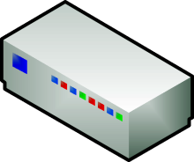


Scalability
GET http://fabrikam.com/API/User/42

Slide 6
Guiding principles of REST-interfaces
Identification of resources
Manipulation of resources through representations of these resources
Self-descriptive messages
Hypermedia as the engine of application state
Notes:
Identification of resources
Individual resources are identified in requests, for example using URIs in web-based REST systems. The resources themselves are conceptually separate from the representations that are returned to the client. For example, the server does not send its database, but rather, perhaps, some HTML, XML or JSON that represents some database records expressed, for instance, in Finnish and encoded in UTF-8, depending on the details of the request and the server implementation.
Manipulation of resources through these representations
When a client holds a representation of a resource, including any metadata attached, it has enough information to modify or delete the resource on the server, provided it has permission to do so.
Self-descriptive messages
Each message includes enough information to describe how to process the message. For example, which parser to invoke may be specified by an Internet media type (previously known as a MIME type). Responses also explicitly indicate their cacheability.
Hypermedia as the engine of application state
Clients make state transitions only through actions that are dynamically identified within hypermedia by the server (e.g. by hyperlinks within hypertext). Except for simple fixed entry points to the application, a client does not assume that any particular actions will be available for any particular resources beyond those described in representations previously received from the server.

Slide 7
HATEOAS
Hypermedia as the engine of application state

Slide 8
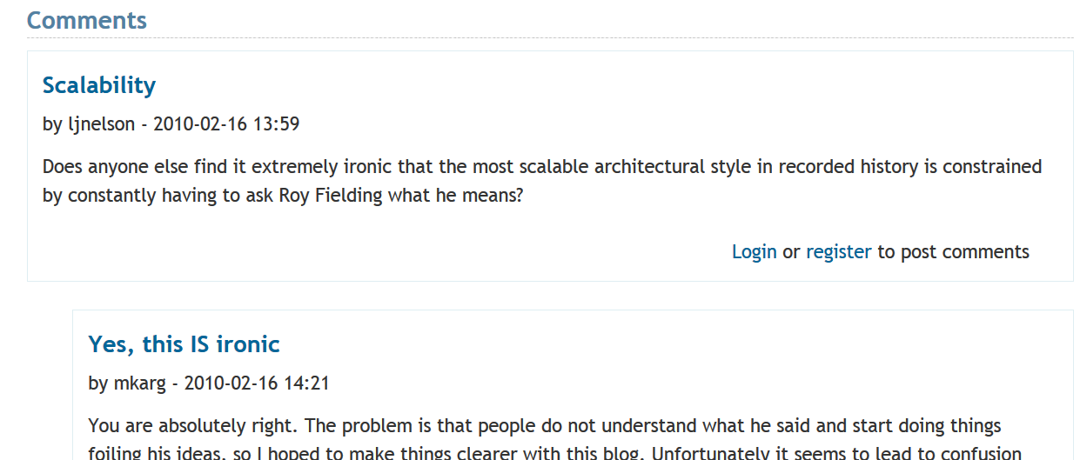

Slide 9
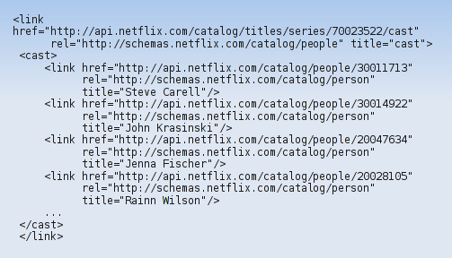
Example of hypermedia representation (Netflix)

Slide 10
Richardsons maturity model
Glory of REST
Level 3: Hypermedia Controls
Level 2: HTPP Verbs
Level 1: Resources
Level 0: The swamp of POX
Notes:
developed by Leonard Richardson

Slide 11
REST on Microsoft – some history
WCF pre-3.5: painful…
WCF 3.5: WebHttpBinding.
WCF REST Starter Kit (no longer supported)
WCF Data Services (OData)
WCF Web API - Preview 1 - 6

Slide 12
WCF ASP.NET Web API

Slide 13
http://www.asp.net/web-api
Goal: One HTTP/ REST / Hypermedia API Fx
Integrated in ASP.NET: Best of both world

Slide 14
WCF to ASP.NET Web API
WCF Web API ASP.NET Web API
Service => Web API controller
Operation => Action
Service contract => n/a
Endpoint => n/a
URI templates => ASP.NET Routing
Message handlers => Same
Formatters => Same
Operation handlers => Filters, model binders

Slide 15
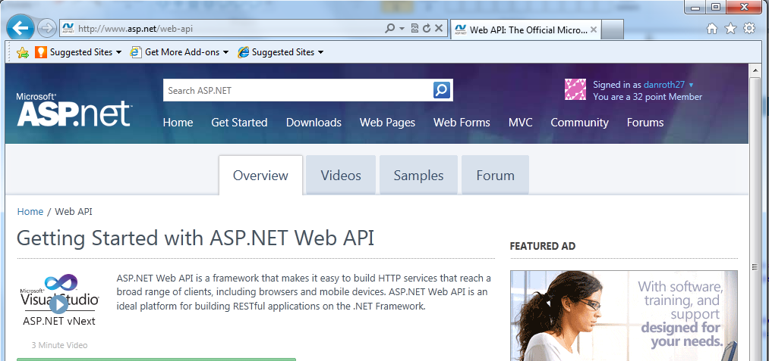
DEMO – File new
Notes:
Not a whole lot

Slide 16
Media types & Media Formatters

Slide 17
Media types & Media Formatters
Built in support for:
  XML
  JSON
  form-urlencoded data
Can be extended with custom Media Formatters

Slide 18
DEMO – Media Type formatter

Slide 19
Parameter Binding
From querystring: using Model binding
From body: using Formatters

Slide 20
Web API on NuGet
Web API hosted in ASP.NET:
  AspNetWebApi
Self-hosted Web API:
  AspNetWebApi.Selfhost
HttpClient including XML and JSON formatters:
  System.Net.Http.Formatting
JsonValue for navigating and manipulating JSON:
  System.Json Newtonsoft.Json

Slide 21
Node-style Web API?
http://blogs.msdn.com/b/youssefm/archive/2012/02/24/
writing-a-lightweight-web-service-using-webapi-building-blocks.aspx

Slide 22
DEMO – SELF HOSTING

Slide 23
Web API can be used for all levels
Glory of REST
Level 3: Hypermedia Controls
ASP.NET Web API
Level 2: HTPP Verbs
Level 1: Resources
Level 0: The swamp of POX

Slide 24
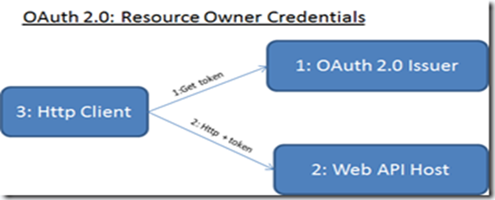
OAuth/Claims based security
http://zamd.net/

Slide 25
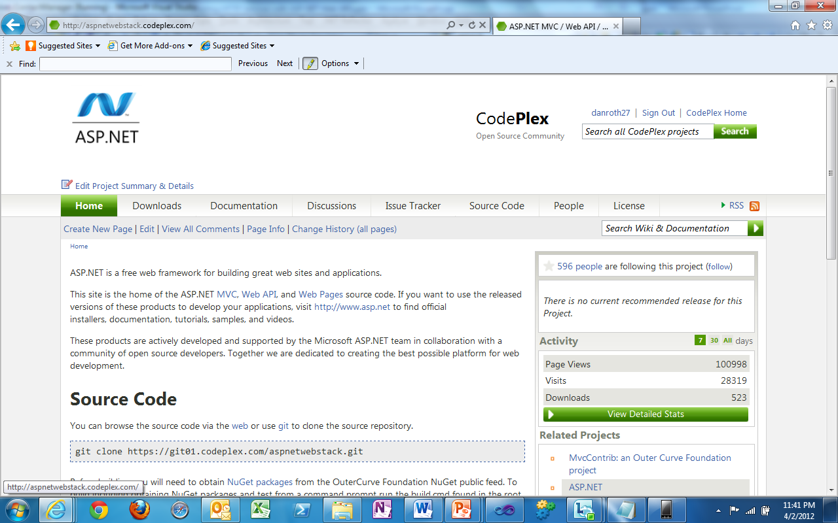
Open Source: http://aspnetwebapi.codeplex.com

Slide 26
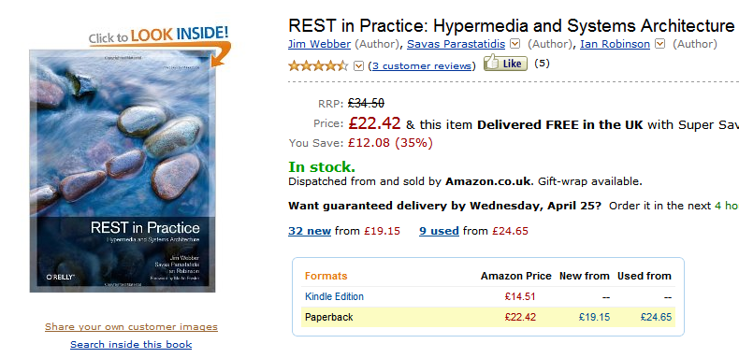
Some good reading

Slide 27
Thank you!
Robert Folkesson | Active Solution
robert.folkesson@activesolution.se | @rfolkes
www.robertfolkesson.se

